Slide 1
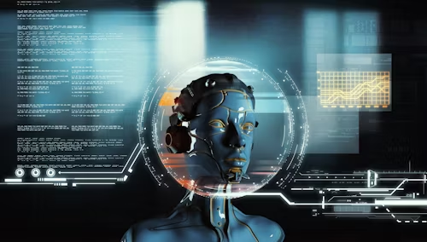

Machine Learning and the Importance of Machine Ethics
Professional Practice
Names Surname StudentNumber
Xolani Masimbe 222410817
Seja Hope Kgomokaboya 222152672
Rotondwa Delight Rambau 222342145
Natasha Njili 221785345
Puleng Veronica Nakedi 222914556

Slide 2

Topics covered
Topics covered
What is Machine Learning?
Applications of Machine Learning
Why Ethics in ML Matters
Risks Without Ethics
What is Machine Ethics?
Key Principles of Machine Ethics
Fairness Example
Self-Driving Cars Example
Benefits of Ethical ML
The Future of Machine Ethics
Conclusion

Slide 3

Introduction to ML
Machine Learning (ML) is transforming industries worldwide.
As ML grows, ethical concerns must also be addressed.
Ethics ensures ML systems are trustworthy and safe.
Goal: Create machines that are both intelligent and responsible.
Ethics bridges the gap between innovation and human values.

Slide 4

What is Machine Learning?
ML is a subset of Artificial Intelligence (AI).
It enables computers to learn from data instead of explicit programming.
Uses algorithms to identify patterns and make predictions.
Continuously improves as more data is processed.
Examples: spam filters, voice recognition, recommendation systems.

Slide 5
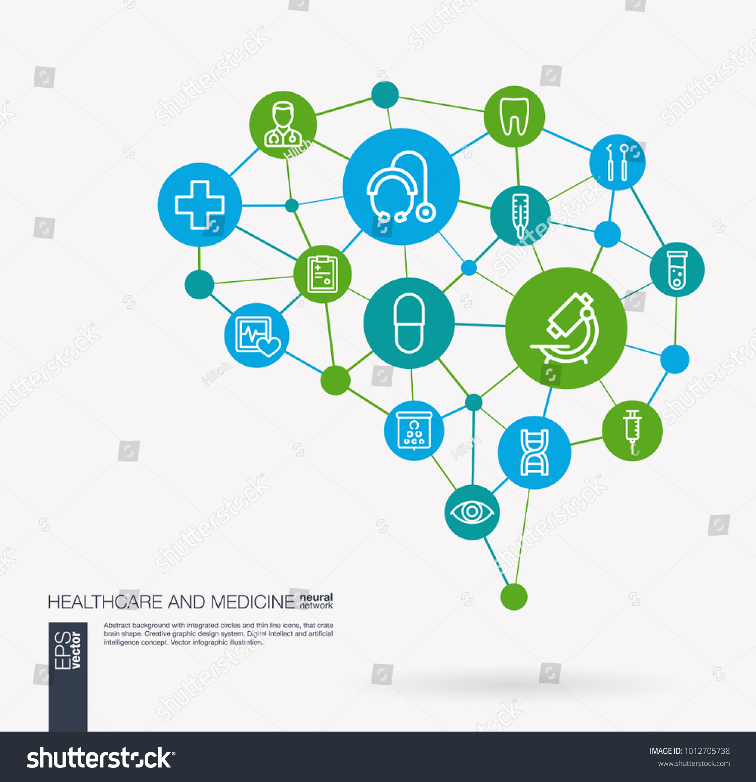
Applications of Machine Learning
Healthcare: Disease prediction, drug discovery, patient monitoring.
Finance: Loan approvals, fraud detection, stock market predictions.
Education: Personalized learning paths, grading automation.
Transport: Self-driving cars, traffic management, predictive maintenance.
Retail: Customer recommendations, inventory forecasting.
Agriculture: Crop monitoring, weather predictions, pest detection.

Slide 6
Why Ethics in ML Matters
ML systems affect jobs, education, healthcare, and law enforcement.
Unethical ML may reproduce or amplify human biases.
Ethics ensures decisions remain fair and unbiased.
Critical for protecting privacy and human dignity.
Helps maintain trust between people and technology.

Slide 7
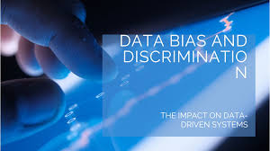
Risks Without Ethics
Bias and Discrimination – unfair outcomes based on race, gender, etc.
Privacy Violations – misuse of personal and sensitive data.
Unfair Decisions – inaccurate or one-sided outcomes.
Job Displacement – automation without safeguards.
Loss of Trust – people may reject AI systems if they are unfair or unsafe.

Slide 8
What is Machine Ethics?
Machine ethics = embedding moral principles into ML systems.
Involves programming machines to respect fairness and rights.
Helps align AI decision-making with human values.
Goes beyond accuracy—focuses on responsibility and accountability.
Core idea: machines should 'do the right thing' automatically.

Slide 9
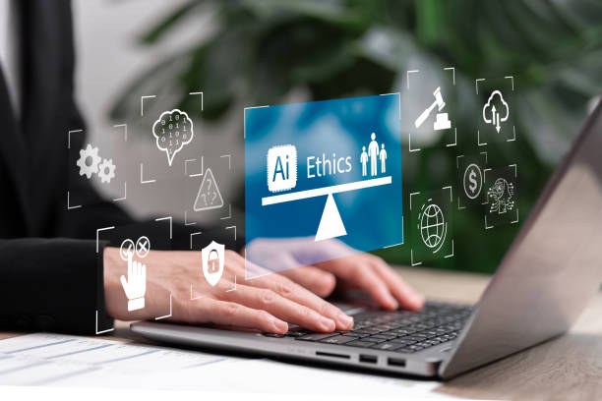
Key Principles of Machine Ethics
Fairness – Avoid bias and ensure equality.
Transparency – Explain decisions clearly.
Privacy – Protect user data from misuse.
Accountability – Trace responsibility for AI outcomes.
Respect for Human Values – Preserve dignity, safety, and rights.
Inclusivity – Ensure all groups are represented in training data.

Slide 10
Fairness Example
Loan approval systems must treat all applicants equally.
Data should not discriminate based on race, gender, or background.
Bias in training data must be corrected before deployment.
Example: Balanced datasets lead to fairer decisions.
Fairness ensures equal access to financial opportunities.

Slide 11

Self-Driving Cars Example
Cars must make ethical decisions during emergencies.
Example: Choosing between passenger and pedestrian safety.
Accountability needed in accidents involving autonomous vehicles.
Ethics guide car manufacturers in safety design.
Self-driving ethics involve law, policy, and technology together.

Slide 12
Benefits of Ethical ML
Builds trust in AI technologies.
Protects people from harm and unfair treatment.
Promotes fairness and equality across all sectors.
Encourages responsible innovation.
Strengthens relationships between humans and AI.
Supports global collaboration and acceptance of AI.

Slide 13
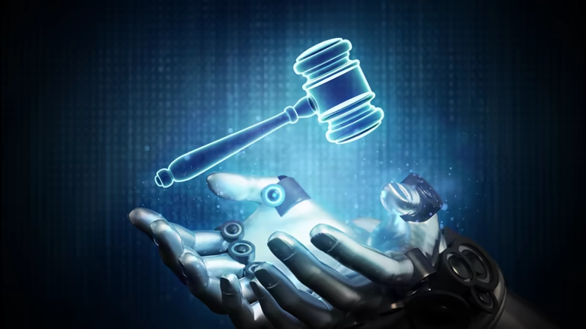
Conclusion
Machine learning is powerful but can cause harm if misused.
Ethics ensures technology respects human values.
The goal is not just smart machines, but responsible ones.
Trustworthy AI = innovation + fairness + accountability.
Ethical ML is key to a safer and fairer future.

Slide 14
References
Bostrom, N. & Yudkowsky, E., 2014. The ethics of artificial intelligence. In: K. Frankish & W. M. Ramsey, eds. The Cambridge Handbook of Artificial Intelligence. Cambridge: Cambridge University Press, pp.316–334.
Jobin, A., Ienca, M. & Vayena, E., 2019. The global landscape of AI ethics guidelines. Nature Machine Intelligence, 1(9), pp.389–399. https://doi.org/10.1038/s42256-019-0088-2
Russell, S., Dewey, D. & Tegmark, M., 2015. Research priorities for robust and beneficial artificial intelligence. AI Magazine, 36(4), pp.105–114.
Floridi, L. et al., 2018. AI4People—An ethical framework for a good AI society: Opportunities, risks, principles, and recommendations. Minds and Machines, 28(4), pp.689–707.
Mittelstadt, B.D. et al., 2016. The ethics of algorithms: Mapping the debate. Big Data & Society, 3(2). https://doi.org/10.1177/2053951716679679

Slide 15
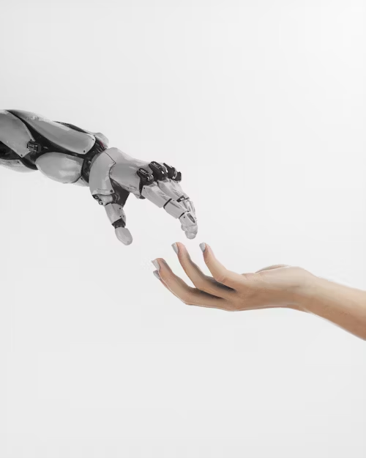
Thank you ☺

